Slide 1

Airbnb Hotel Booking Analysis
SHUBHRA SAMANTA
INTERNSHIP_17546440516895be537820f

Slide 2

PROBLEM STATEMENT
The rapid growth of Airbnb has transformed the hospitality industry, creating new opportunities and challenges in urban markets like New York City. However, stakeholders often lack clear insights into factors driving listing availability, pricing strategies, host behavior, and guest satisfaction. This project analyzes Airbnb’s open dataset for NYC to uncover patterns and relationships that can inform hosts, travelers, and policymakers about the dynamics of short-term rentals.

Slide 3
Project Description
This project explores the Airbnb Open Data for New York City to uncover insights into the short-term rental market. Using data cleaning, exploratory analysis, and visualization, the study examines property types, neighborhood trends, pricing patterns, host characteristics, and guest reviews. The goal is to identify key factors influencing availability, affordability, and customer experience, providing valuable guidance for hosts, travelers, and policymakers in navigating the evolving landscape of urban hospitality.

Slide 4

WHO ARE THE END USERS?
Hosts → to understand pricing, availability strategies, and how identity verification or review ratings affect their performance.
Guests (Travelers) → to make informed decisions about neighborhoods, property types, and expected prices or reviews.
Policymakers & City Planners → to analyze the impact of short-term rentals on housing, affordability, and neighborhood dynamics.
Researchers & Data Analysts → to study trends in the sharing economy and urban tourism.
Hospitality Industry Stakeholders → hotels, rental companies, or investors comparing performance against Airbnb.

Slide 5

Technology Used
Python 3 – core programming language for data analysis
Pandas & NumPy – data cleaning, manipulation, and numerical analysis
Matplotlib & Seaborn – data visualization and statistical plotting
Jupyter Notebook / Google Colab – interactive development and analysis environment
Excel/CSV Handling (openpyxl, pandas) – to load and process Airbnb datasets

Slide 6
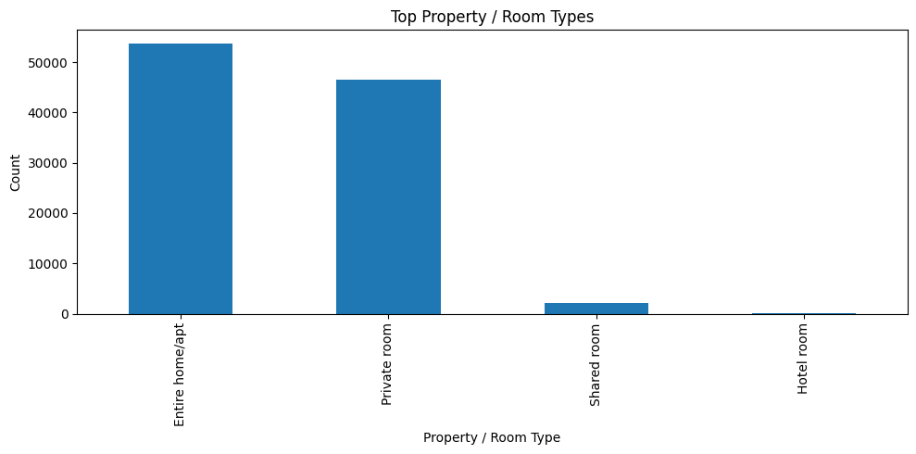
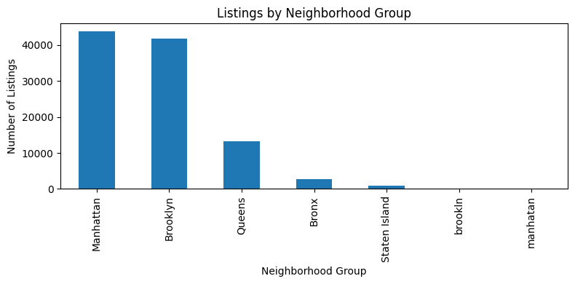
RESULTS1

Slide 7
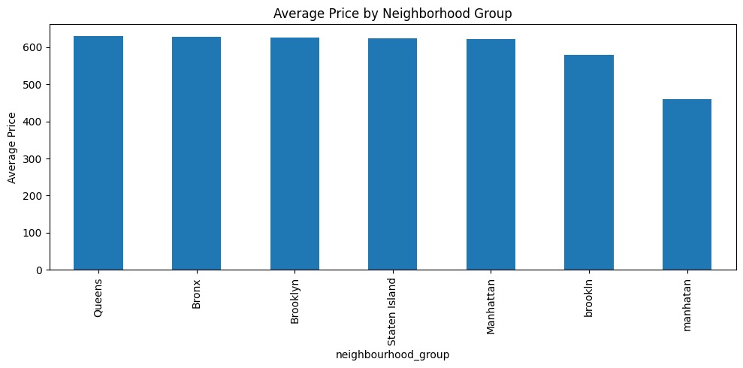
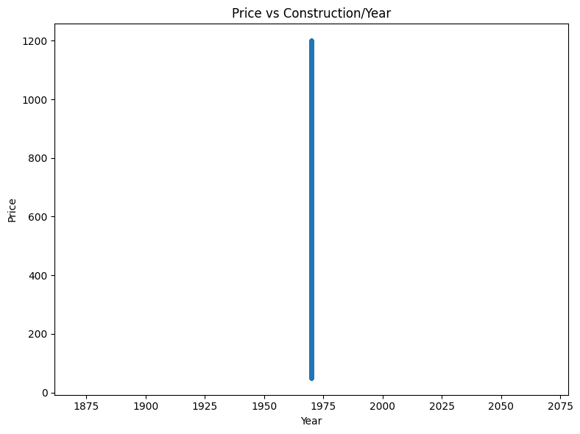
RESULTS2

Slide 8
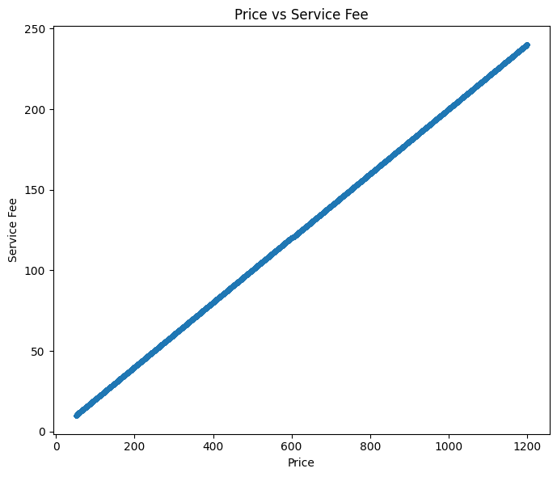
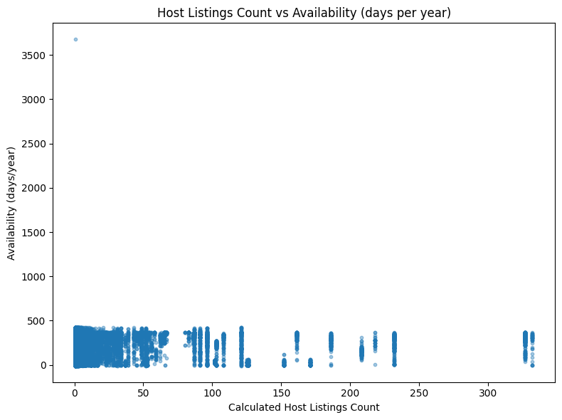
RESULTS3

Slide 9
GitHub repository
https://github.com/SubhraX/VOIS_AICTE_Oct2025_SHUBHRA_SAMANTA.git

Slide 10
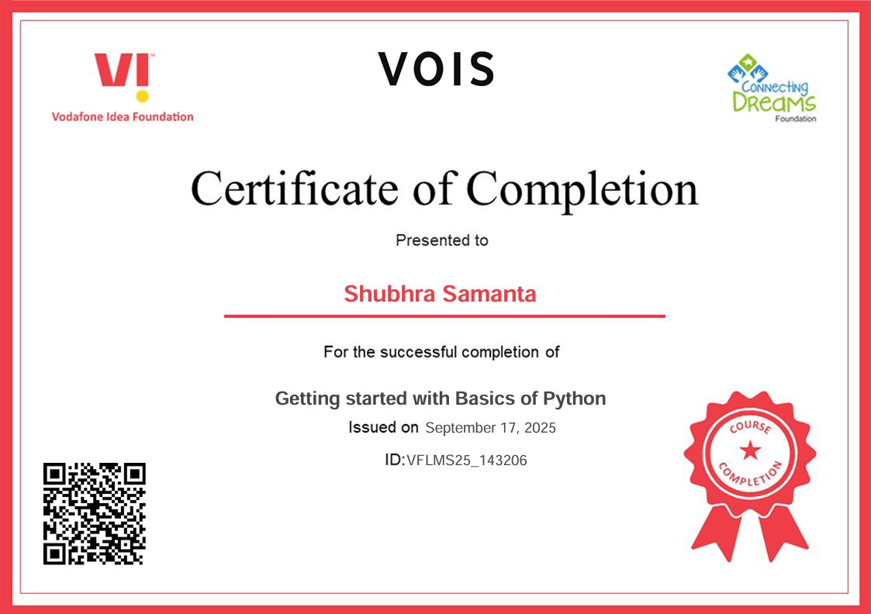
Getting started with Basics of Python Certificate

Slide 11

Data Visualization Certificate

Slide 12
Thank you
.
.

